Slide 1

Mentors Asylum
Team Name : CS Bunny

Slide 2
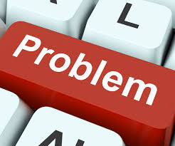
Developers and coders very frequently gets stuck in problems for which they need help from some experts in that field. For this they face problems given below :
They search for the solution over the internet.
They spent huge amount of time to get the solution.
It may happen that the communication between the developer/coder and expert couldn’t be properly threaded due to communication issues.
Sometimes solution provided is not good enough to solve the problem and one has to restart from beginning.

Slide 3

Solution
Registration/Login for two types of user
Developer
Expert
The developer can login and select the field in which he needs help. After this the list of online expert will be listed from which he can select anyone and request for help via video call, text chatting and collaborative code editor. After getting the solution the developer is supposed to pay a small amount as a thank you token.

Slide 4
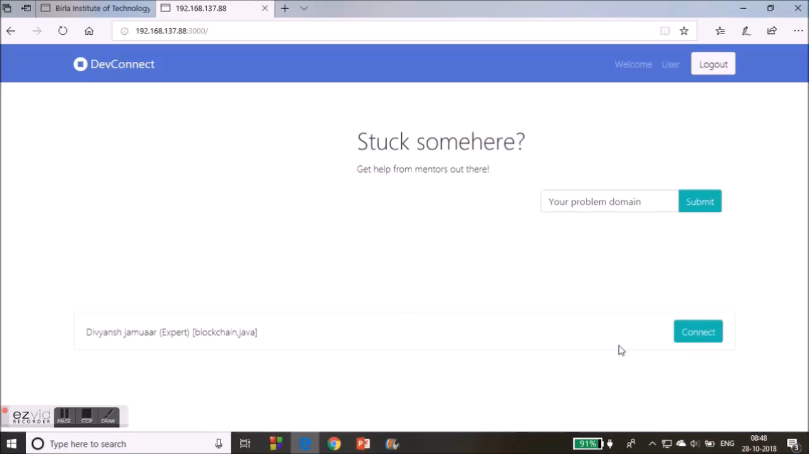
Online Session via Video chat
The developer and expert can have an online video chat session in which developer can directly interact with the expert and can very easily and effectively ask for the solution.

Slide 5
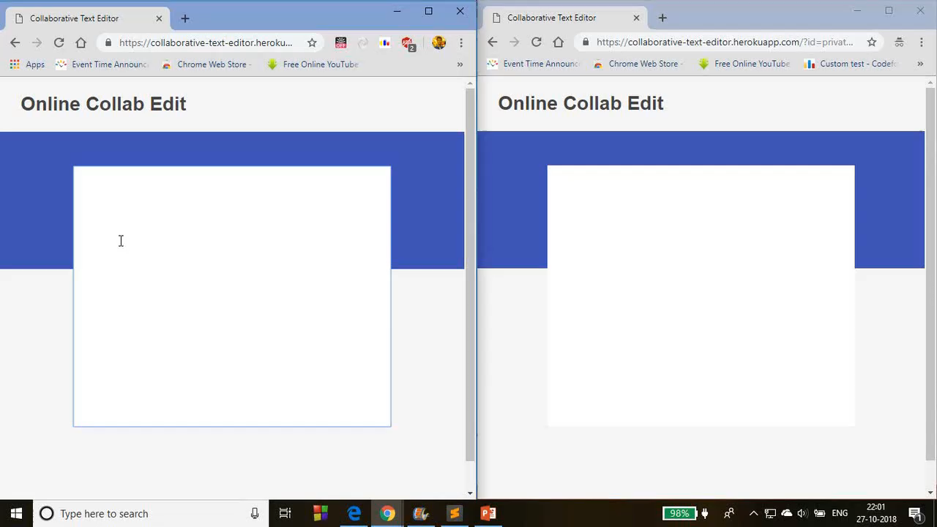
Collaborative Code Editor
The developer and expert can access the same code editor at the same time and can do editing which helps in easy code debugging.
Expert
Developer

Slide 6
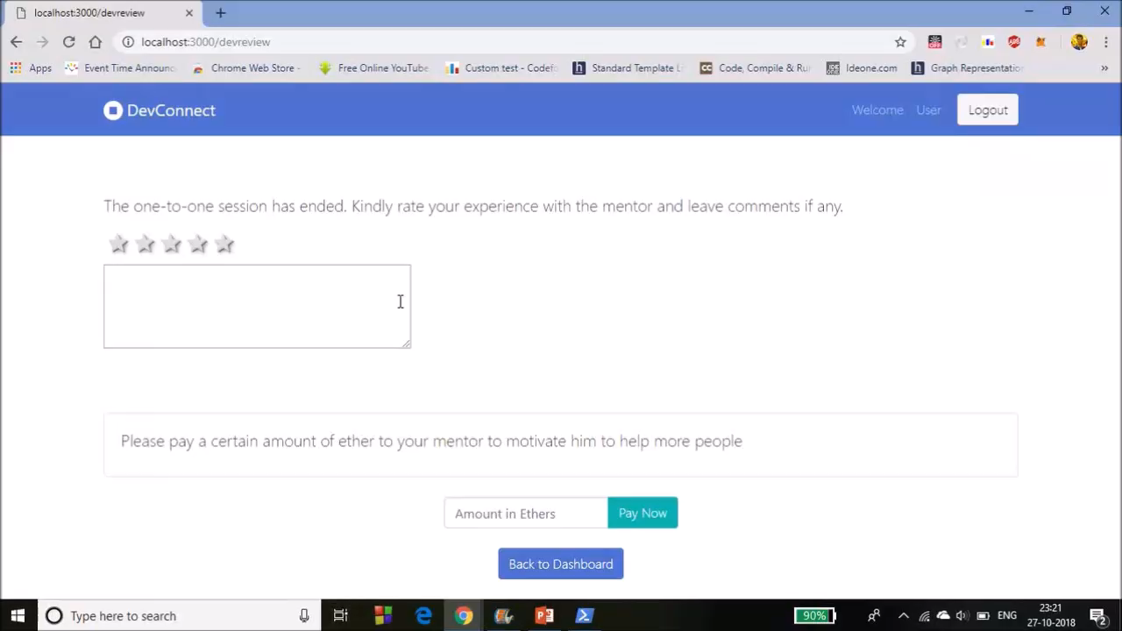
Payment via Ether
The developer after getting the problem solved can very easily pay a small amount of money as a token of thanks.

Slide 7
Next Steps

Slide 8
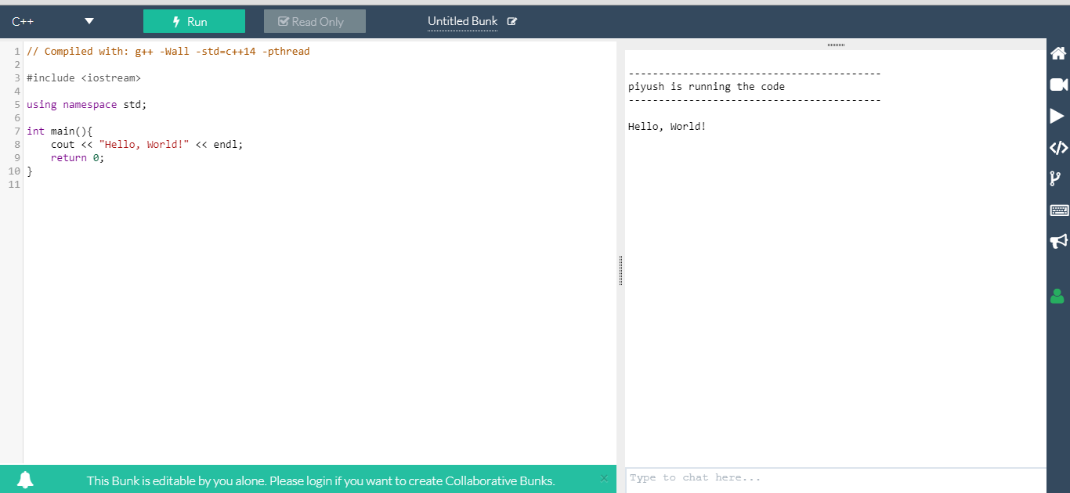
Collaborative text editor will be converted in online compiler so that any further error in the code can be solved at that time via compiling.

Slide 9
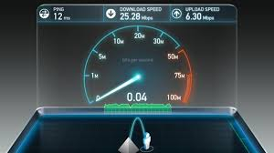
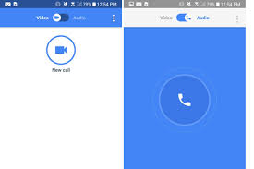
The session can be automatically changed from video to audio if the internet speed is slow.

Slide 10

The expert can reschedule the call request as per his priorities.

Slide 11
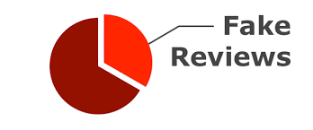
Implement a strong review system that ensures no one can misuse the platform to waste the time of experts and annoy them unnecessary.

Slide 12


Improving the overall user interface and user experience of the website and providing language support and various themes to the collaborative code editor.

Slide 13

Thank You
Divyansh Jamuaar
Lal Rishav
Piyush Kumar

